Slide 1
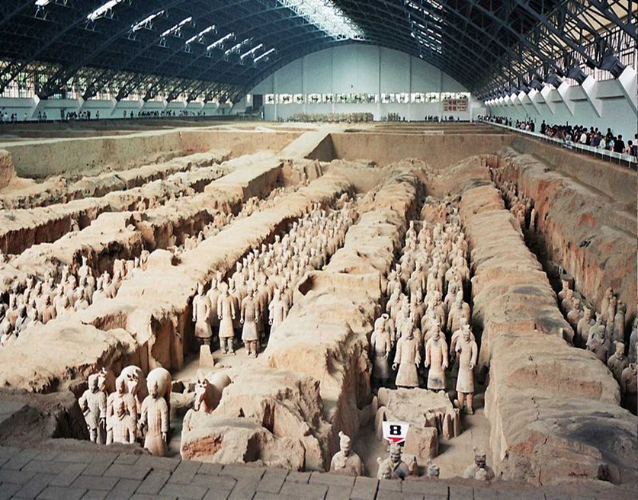
Qin Warriors
The Terracotta Army is a collection of terracotta sculptures depicting the army of Qin Shi Huang, the first emperor of China. This is a form of funeral art that was buried with the emperor in 210-209 BC to protect him in the after life. They were discovered in 1974 by local farmers in Lintong District, Xi'an, Shaanxi province. Current estimates are that in 3 pits there are 3000 soldiers, 130 chariots, 520 horses, and 150 cavalry horses. In other pits non-military figures were found.

Slide 2
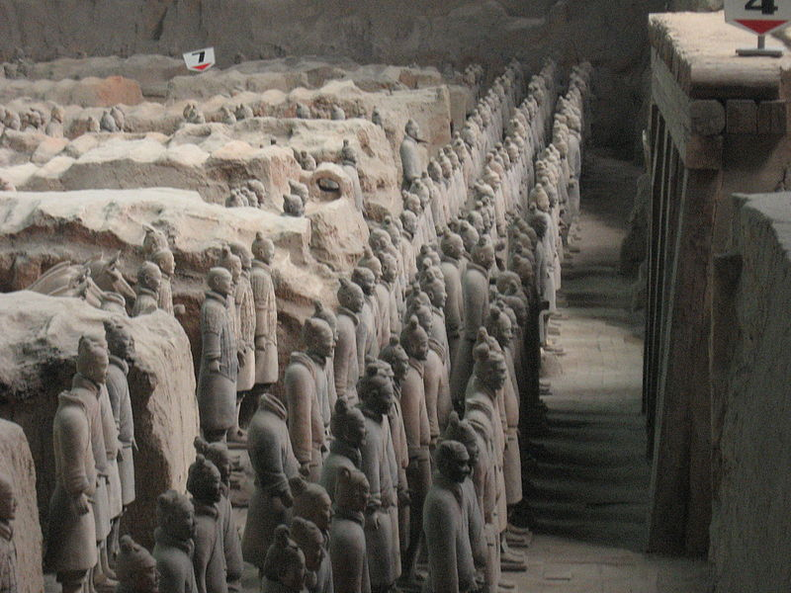
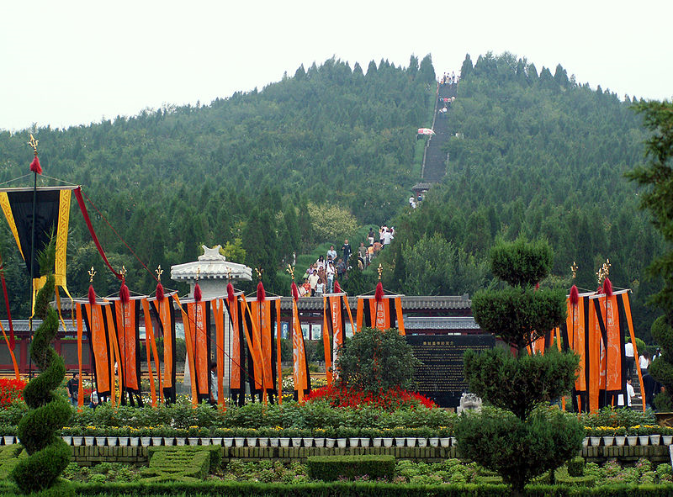
(Below)The mound where the tomb is located
(Above) View of the Terracotta Army

Slide 3
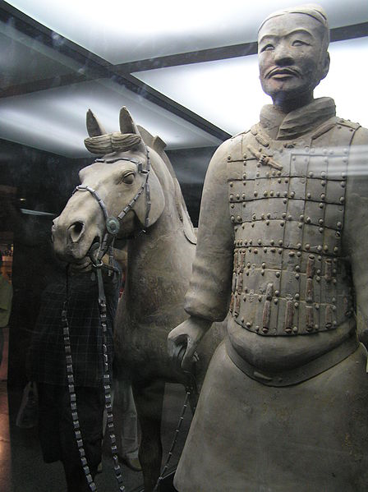
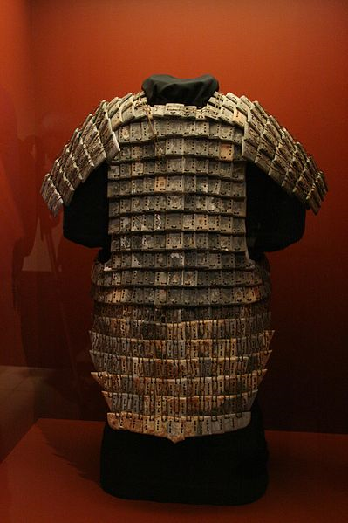
A terracotta soldier with his horse
Stone armor suit on display in the National Geographic Museum, USA

Slide 4
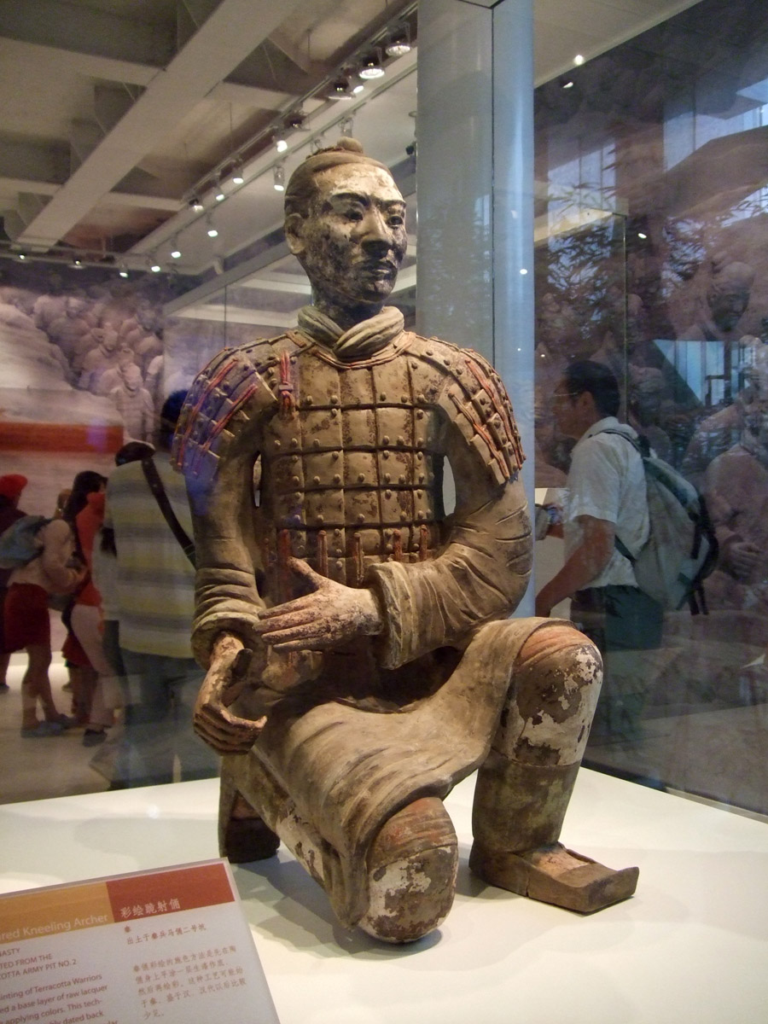
The Terracotta Warriors used to be painted full of color - now only a handful of statues still contain small amounts of color. Notice the incredible detail put into the soles of the warrior's shoes.
Terracotta Warrior, kneeling figurine.

Slide 5
Note how the faces of these two soldiers differ from each other. Each statue was constructed to be unique
Sword in Emperor Qin's Mausoleum

Slide 6
Bronze chariot awaits for the emperor

Slide 7
These recreations show many of the vibrant colors they used for their statues.

Slide 8
Terracotta horse and two soldiers
A cavalryman and his mount

Slide 9
Terracotta Warrior locations

Slide 10
In 1974 some Chinese farmers working at establishing a water well at a rural location in Lintong county, Shaanxi province, near Xian, China, stumbled upon an astonishing find in the form of some large-scale terracotta warriors buried in the ground in which they were digging. These few figures proved to be only an "advance guard" of an eventual chinese terracotta army of warriors that has been dated to around 210 B.C. and is believed to have been created by the command of Qin Shi Huang who was the first Emperor of a unified China. The words Shi Huang translate as - First Emperor - so this individual is also known as the first Emperor of the Qin dynasty. The Chinese civilization he led had its roots located in Shaanxi and Henan provinces where the Huang He, or Yellow River, winds its way through its fertile valleys. The Han Chinese settled this area in the 3rd century BC. Xi'an, the capital of Shaanxi Province, lies just a few miles to the west of where the Wei and Huang He converge.

Slide 11
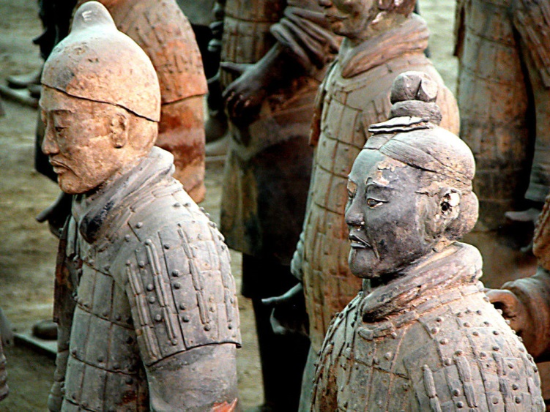
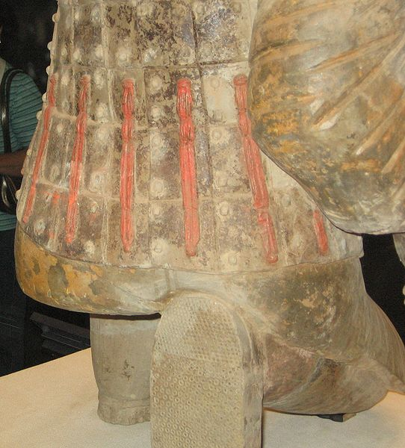

Slide 12
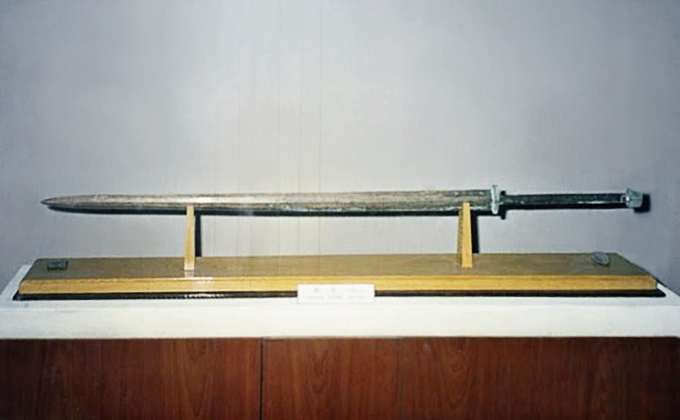

Slide 13
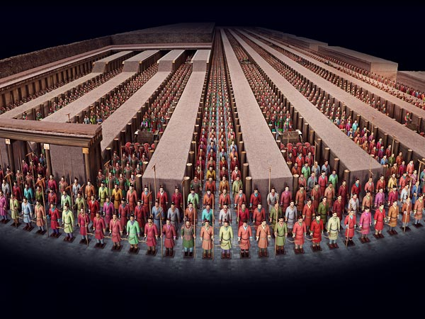
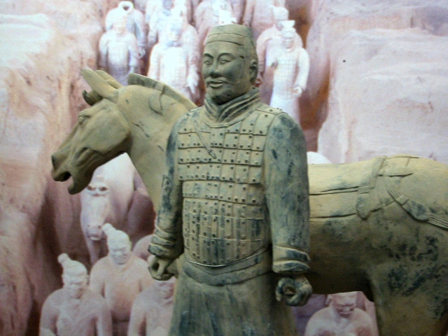

Slide 14
